Slide 1
Graphical User Interface File Manager
Made By: Aatif Pathan (1/23/SET/BCS/572)
Risab G.C. (1/23/SET/BCS/569)
Shourya Khare (1/23/SET/BCS/577)

Slide 2
Objective
The objective of this project is to develop a user-friendly File Manager that allows users to efficiently manage files and directories through an intuitive Graphical User Interface (GUI). The application will provide essential file operations like browsing, opening, copying, moving, renaming, and deleting files in a visually appealing and interactive manner.

Slide 3
Introduction
File Manager project is a Python-based application
that provides a graphical use interface (GUI) to
perform common file operations such as:
File Navigation
Basic File Operations
Search Functionality
Sorting and Filtering

Slide 4
Technologies
Python – Core programming language
Tkinter – GUI toolkit for building the interface
OS Module – Handles file and directory operations
Shutil Module – Used for file copying, moving, and deleting
Pillow (PIL) – Loads and displays icons for files and folders
Filedialog (Tkinter) – Opens folder selection dialogs
ttk (Themed Tkinter Widgets) – Provides enhanced UI elements like `Treeview`

Slide 5
Features
File and Folder Navigation – Open, browse, and navigate directories easily
File Operations – Delete, rename, copy, & move files and folders
Search Functionality – Search for files and folders Graphical User Interface – User-friendly layout using Tkinter
Error Handling – Displays alerts for permission errors and invalid operations
Dynamic Path Display – Shows the current working directory for easy navigation

Slide 6
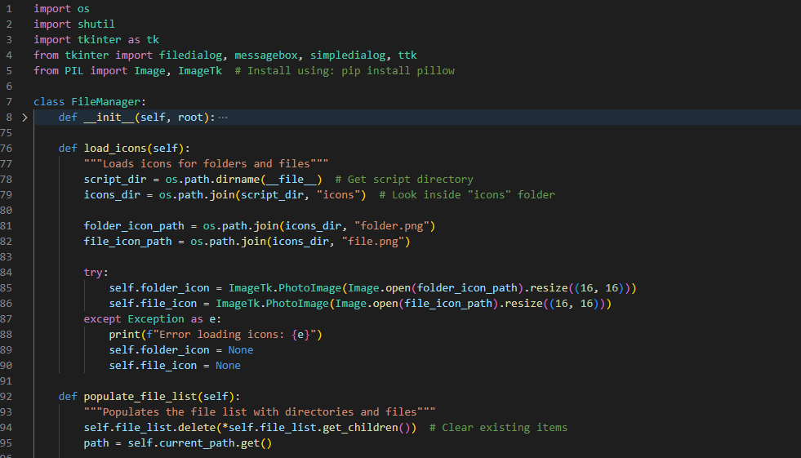
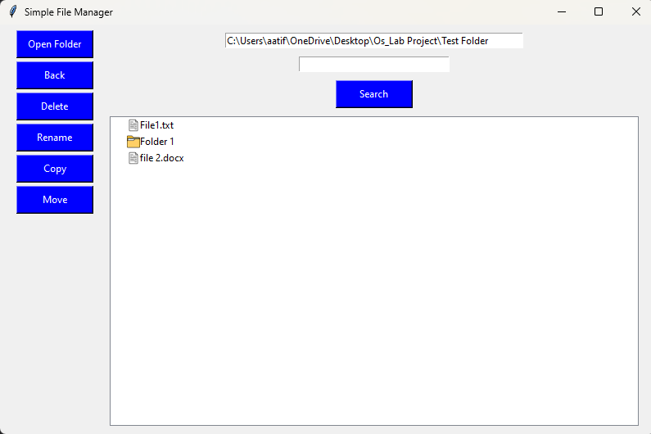
Code Snippets

Slide 7
Live Demonstration of Project

Slide 8
Future Enhancements
Drag and Drop Support
Multi-Tab Browsing
Dark Mode Support
File Preview
Sorting & Filtering
Bookmark Favourite Folders
Zip & Unzip Files

Slide 9
Outcome
Improved file management efficiency
User-friendly and intuitive interface
Seamless file and folder navigation
Enhanced file operations (delete, rename, copy, move)
Quick search functionality for easy access
Better visualization with icons and structured view
Error handling for smooth user experience

Slide 10
Thank You !
View our GitHub repository
https://github.com/AatifPathan/OS-Project-GUI/

